Slide 1
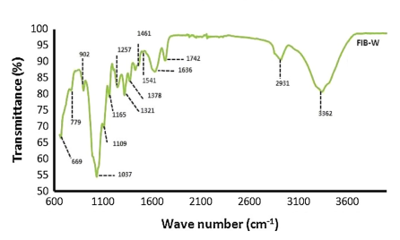
Article Subject (Times New Roman Bold 50)
Author*, Author and Author, …
*University Department, University Name, City, Country, Email
* corresponding author
nicame-0000
Abstract:
Results and discussion:
The Abstract should be written in Times New Roman font size 26. The abstract should be typed as a single paragraph and should only be 250 words or less.
The Result and discussion should be written in Times New Roman font size 26.
This should explore the significance of the results of the work
Fig.1. FTIR spectrum of Agave American fiber extracted from (Times New Roman size 22)
Introduction:
The Introduction should be written in Times New Roman font size 26.
In introduction, state the objectives of the work and provide an adequate background, avoiding a detailed literature survey or a summary of the results.
Material and methods:
Conclusion:
The Material and methods should be written in Times New Roman font size 26.
Provide sufficient details to allow the work to be reproduced by an independent researcher. Methods that are already published should be summarized, and indicated by a reference.
The Conclusion should be written in Times New Roman font size 26.
The main conclusions of the study may be presented in a short Conclusions section
References:
The References should be written in Times New Roman font size 20.

